Slide 1
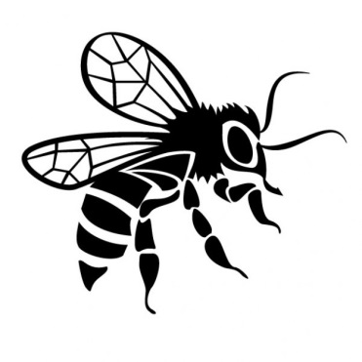
Bees ‘n Beans
Researching garden bees with Sussex University
We’re on the search for volunteers to take part in Bees ‘n Beans, to look at bumblebee populations in gardens and towns across the country. Many wildflowers, along with lots of our favourite garden fruit and veg, need pollination help from bees to succeed – but with bee populations in decline, this important process is under threat.
Do you have enough space in your garden / allotment to grow a few dwarf broad bean plants, and take some easy measurements of your local pollinators at work, to see how well they’re doing? Starting in April 2014, we’ll send you beans, pots and instructions – all you need is a bit of time (and compost!).
Interested? Come look at our project website: ljbees.org.uk
or Twitter: @LJBees – and give us a buzz!

